Slide 1

WHO AM I?
Naveed Sarwar
› Full Stack Developer.
› Freelancer at Upwork & Fiverr.
› Teacher at SMTP.
› StartUp - CodeFrame.tech
› Social Links.
› fb.com/naveed.trainer
› codeframe.tech/
› linkedin.com/in/naveed-trainer

Slide 2
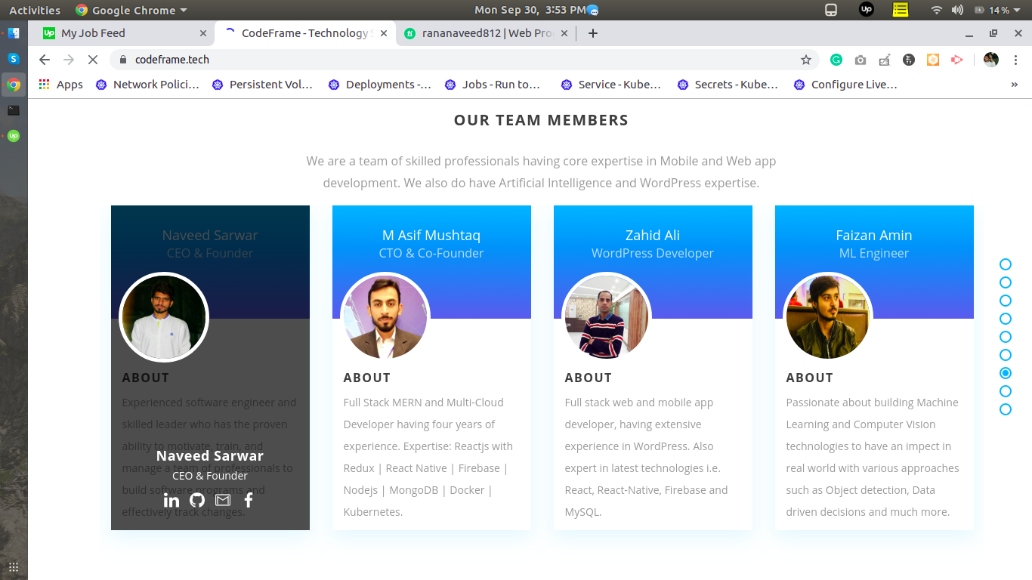
WHO AM I?
fb.com/naveed.trainer

Slide 3
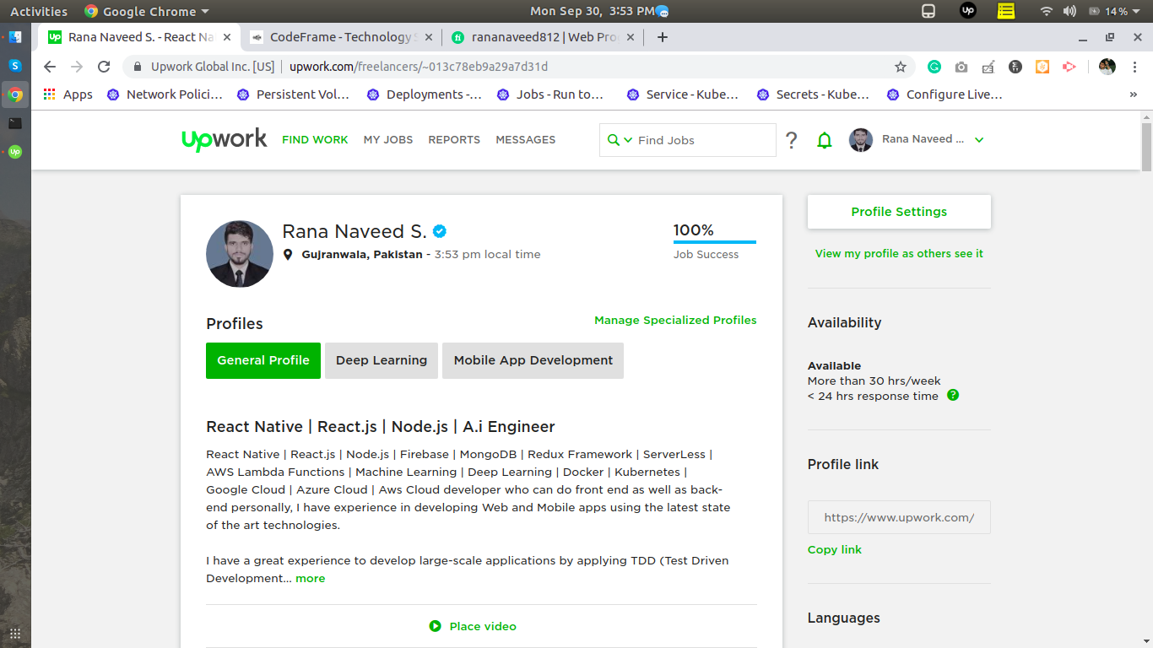
WHO AM I?
fb.com/naveed.trainer

Slide 4
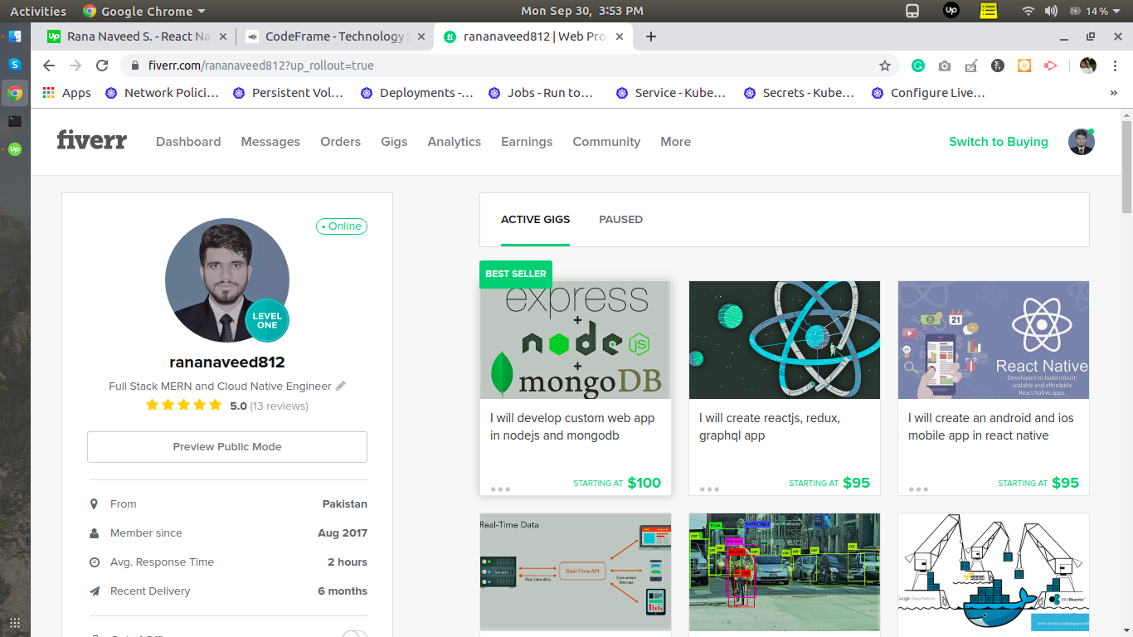
WHO AM I?
fb.com/naveed.trainer

Slide 5


Slide 6


Slide 7


Slide 8

OPTIONS?
1- Job
2- Freelancing / Own Startup
3- Family Business

Slide 9

REQUIREMENT?

Slide 10

IT'S TIME TO SKILL UP

Slide 11
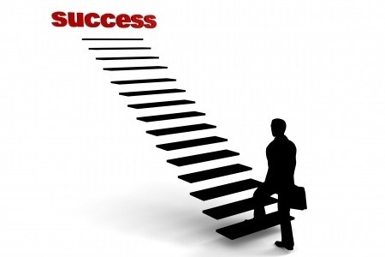
IT'S TIME TO SKILL UP

Slide 12
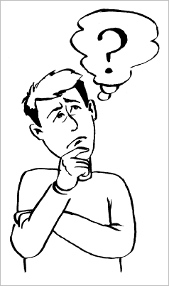
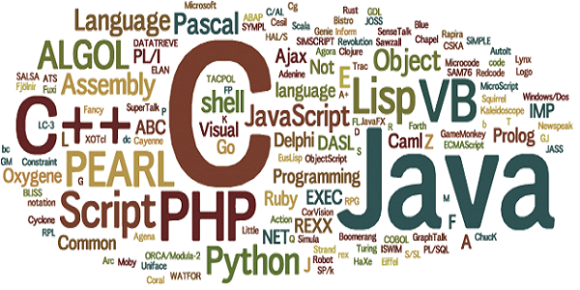
WHAT SHOULD I LEARN?
› There are hundreds of programming languages ​​in use today.

Slide 13
MAJOR AREAS
› Mobile Applications Development.
› Web Development.
› Desktop Applications.
› Blockchain.
› A.I (Artificial Intelligence).
› Graphic Designing.
› Networking.

Slide 14
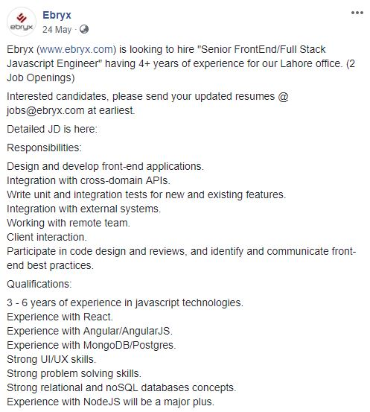
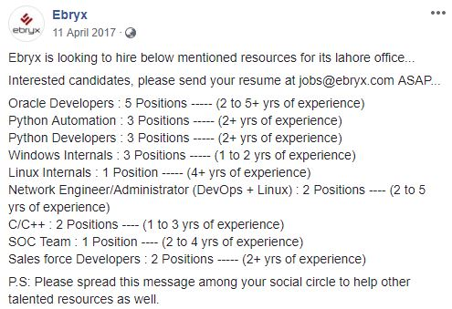
MARKET REQUIREMENTS

Slide 15
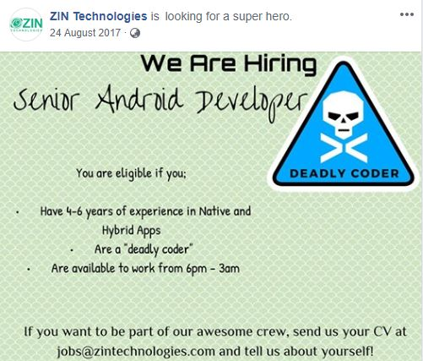
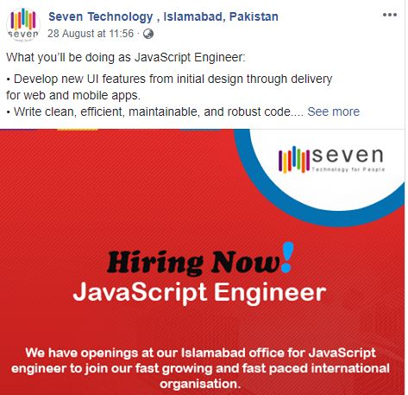
MARKET REQUIREMENTS

Slide 16
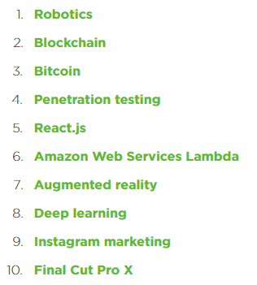
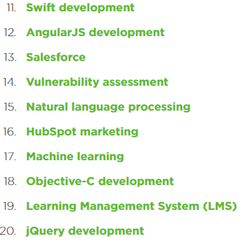
GLOBAL MARKET
Upwork releases the 20 fastest-growing skills for freelancers in Q3 2017

Slide 17
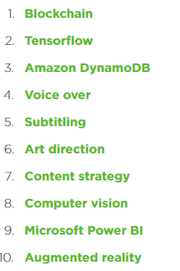
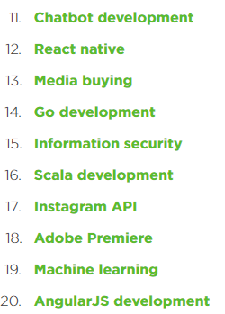
GLOBAL MARKET
Upwork releases Q1 2018 Skills Index

Slide 18
STATE OF THE ART TECHNOLOGIES

Slide 19
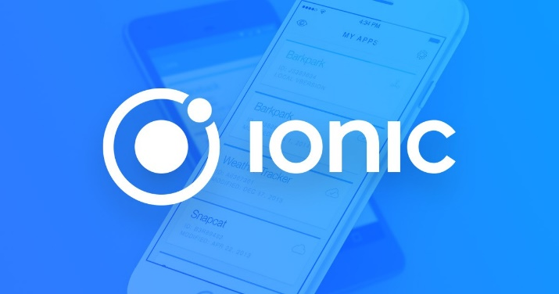
MOBILE APP DEVELOPMENT
› Native Apps.
i- Android App(using java or kotlin).
Ii- Ios App(using Objective C or Swift).
› Market little bit change.
Hybrid applications are web applications (or web pages) in the native browser, such as UIWebView in iOS and WebView in Android (not Safari or Chrome).

Slide 20
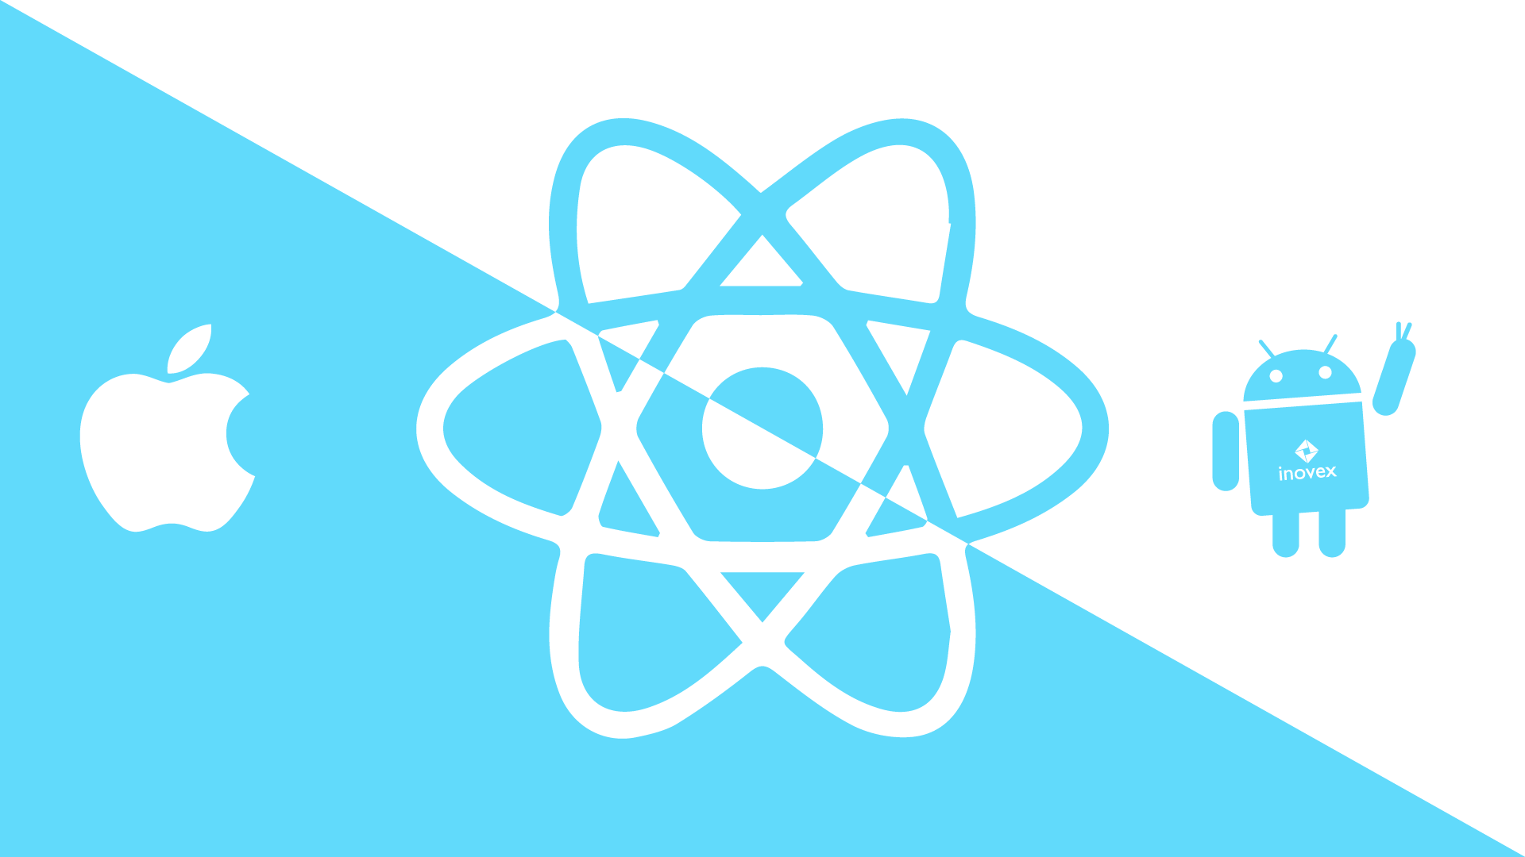
MOBILE APP DEVELOPMENT
› React Native.
React Native is a JavaScript framework maintained by Facebook for writing real, natively rendering mobile applications for iOS and Android.
React Native also exposes JavaScript interfaces for platform APIs, so your React Native apps can access platform features like the phone camera, or the user's location.

Slide 21
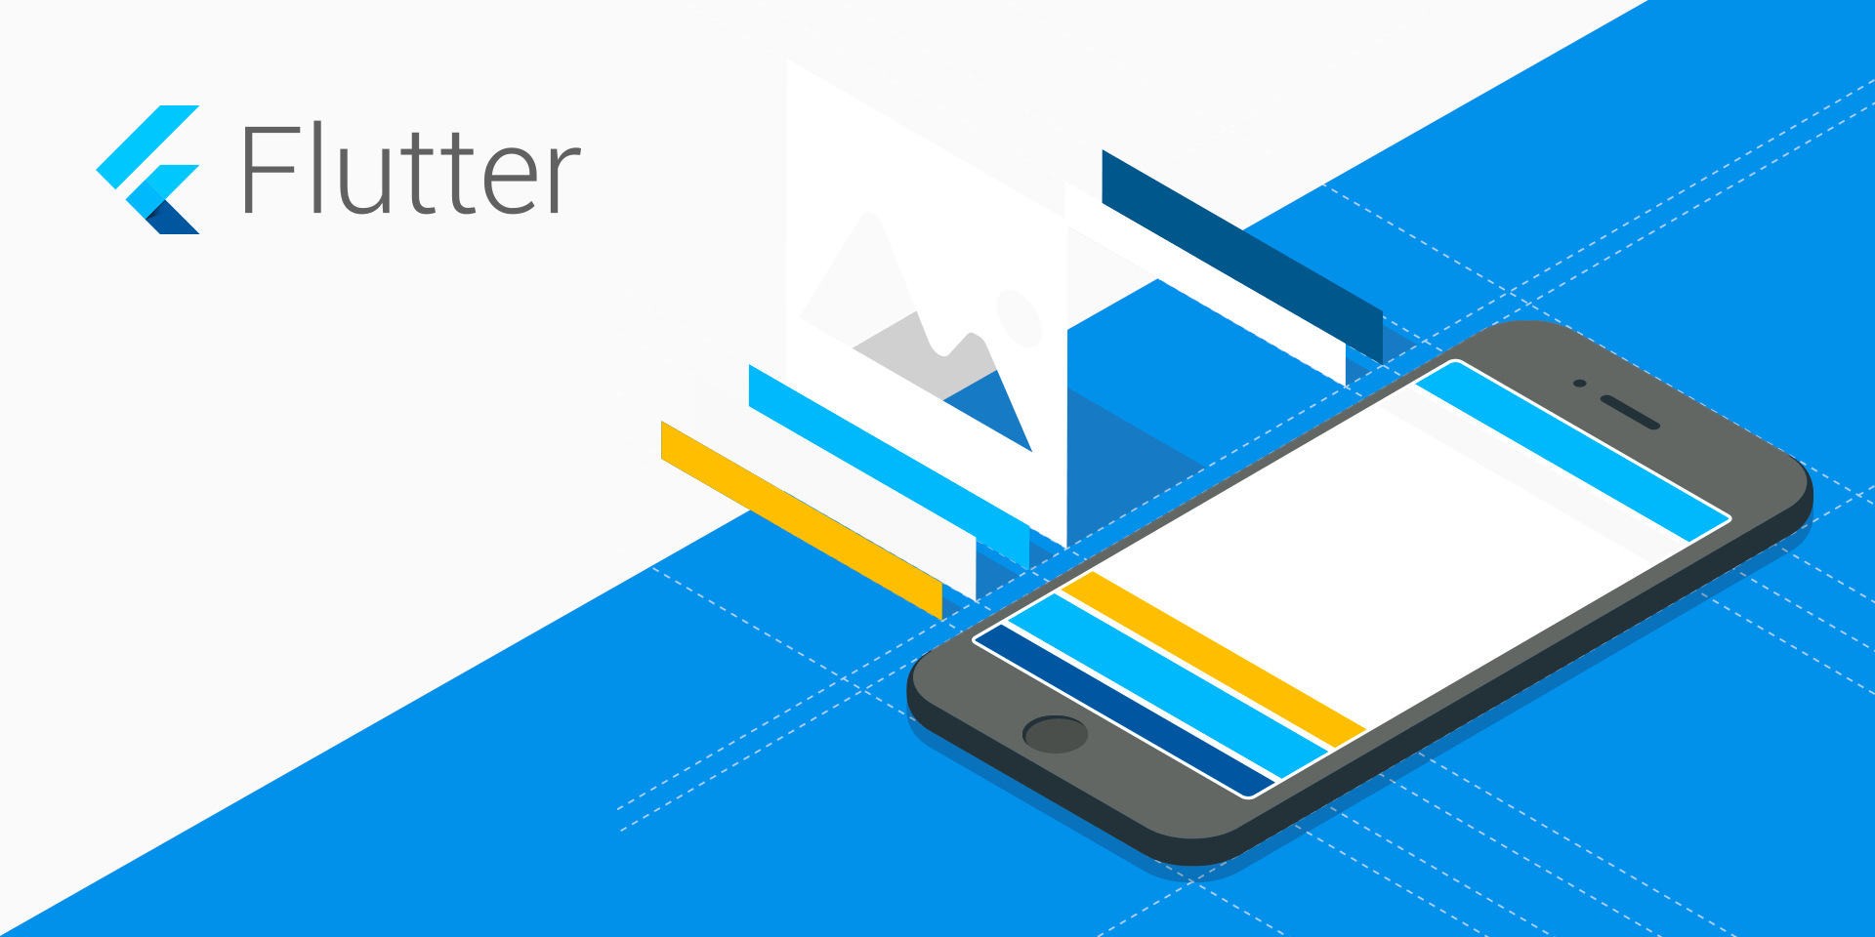
MOBILE APP DEVELOPMENT
› Flutter.
Flutter is Google's mobile app SDK for crafting high-quality native interfaces on iOS and Android in record time.
Flutter works with existing code, is used by developers and organizations around the world, and is free and open source.

Slide 22
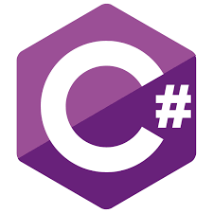
DESKTOP APPLICATIONS
› C #.
C# is a general-purpose, multi-paradigm programming language encompassing strong typing, imperative, declarative, functional, generic, object-oriented, and component-oriented programming disciplines.
C# is very helpful in developing Desktops Applications, because we can easily access the window tools in C#.

Slide 23
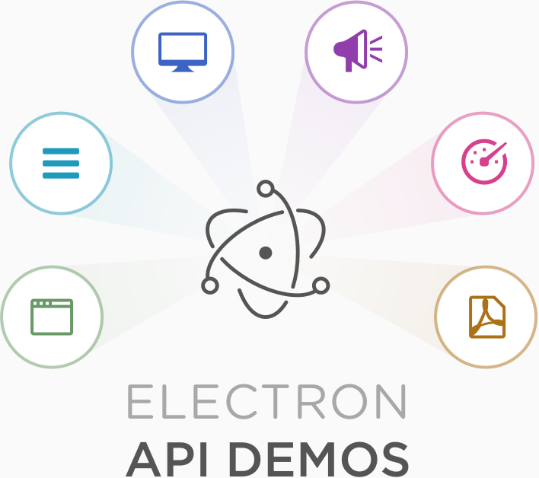
DESKTOP APPLICATIONS
› Electronjs Cross Platform.
Electron is an open-source framework developed and maintained by GitHub.
Electron allows for the development of desktop GUI applications using front and back end components originally developed for web applications: Node.js runtime for the backend and Chromium for the frontend

Slide 24
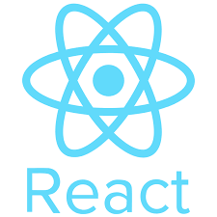
WEB APPLICATIONS
› Frontend.
Past > HTML,CSS,BOOTSTRAP,JQUERY
› Future
i- React:
React is a JavaScript library for building user interfaces. It is maintained by Facebook and a community of individual developers and companies. React can be used as a base in the development of single-page or mobile applications

Slide 25
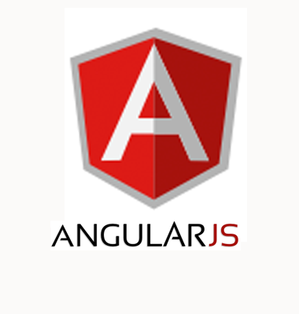
WEB APPLICATIONS
ii- Angularjs:
AngularJS is a JavaScript-based open-source front-end web application framework mainly maintained by Google and by a community of individuals and corporations to address many of the challenges encountered in developing single-page applications.

Slide 26
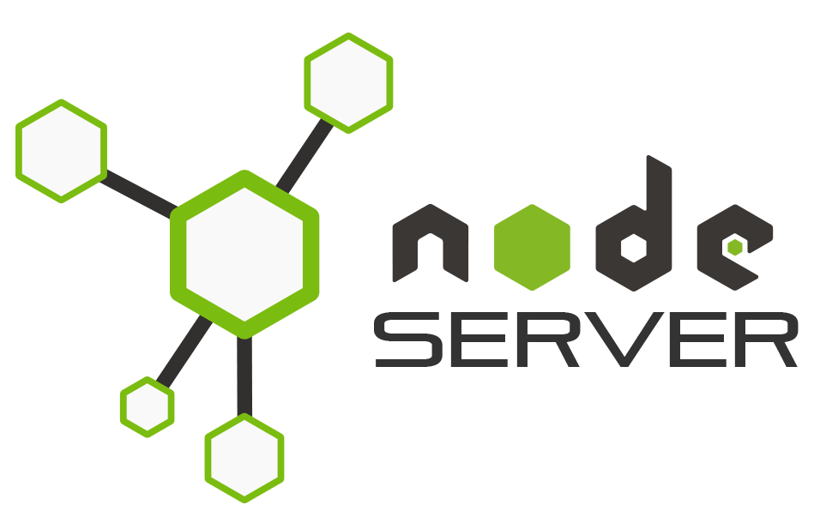
WEB APPLICATIONS
›Backend.
Node.js is an open-source,
cross-platform JavaScript run-time environment that executes JavaScript code outside of a browser.

Slide 27
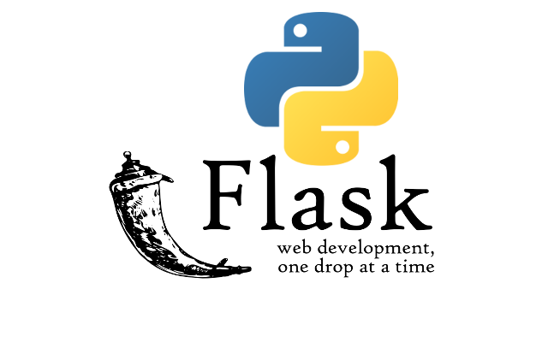

WEB APPLICATIONS
›Python base Backend Server.
Flask is a micro web framework written in Python. It is classified as a microframework because it does not require particular tools or libraries.
Django is a free and open-source web framework, written in Python, which follows the model-view-template architectural pattern.

Slide 28

ARTIFICIAL INTELLIGENCE
›Machine Learning.
Machine learning is a field of computer science that uses statistical techniques to give computer systems the ability to "learn" with data.
Sklearn,openCV
›Deep Learning.
i- Keras
Ii- TensorFlow.

Slide 29
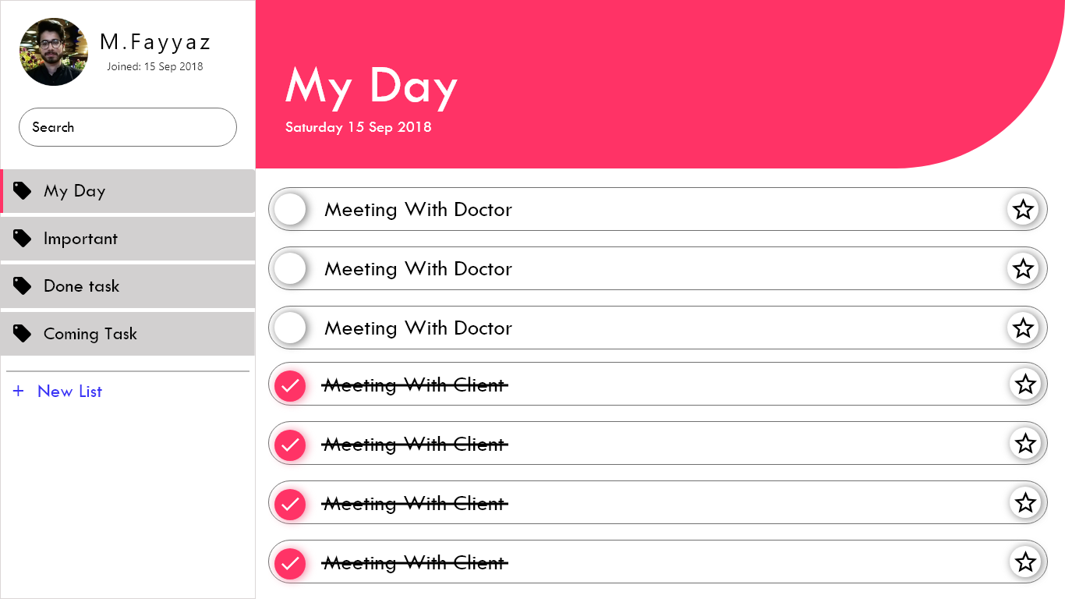
Graphic Designing
›Adobe XD.
Creative User Experience.

Slide 30

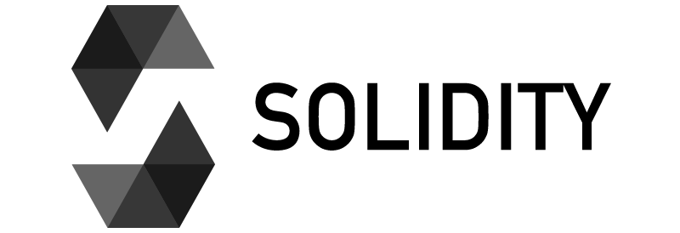
BLOCKCHAIN
›A Blockchain, originally block chain, is a growing list of records, called blocks, which are linked using cryptography. Each block contains a cryptographic hash of the previous block, a timestamp, and transaction data.
Language:
Solidity is a contract-oriented programming language for writing smart contracts.

Slide 31
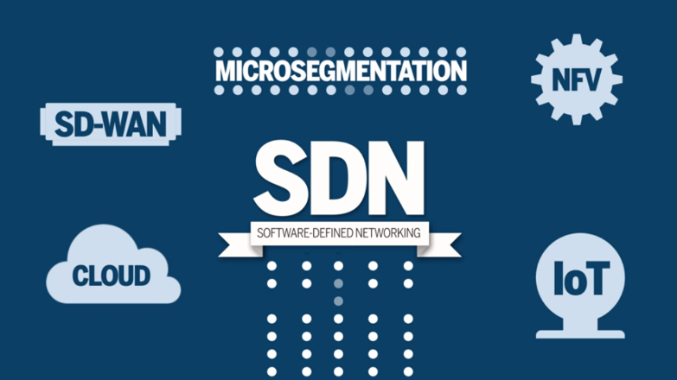

NETWORKING + IOT
›Next Generations Networks 5G Software-defined networking (SDN) and network function virtualization (NFV) (SDN and NFV) are hot topics In networking now a days.
Security is also another benefit that enterprises notice with an SDN. This means you can extend your defense capabilities from simply blocking specific attacks to making proactive changes to adjust to new threats.

Slide 32
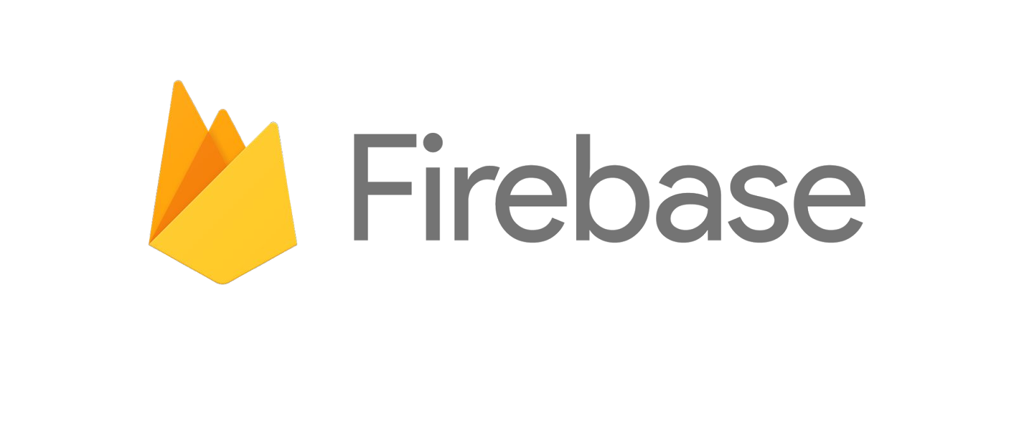
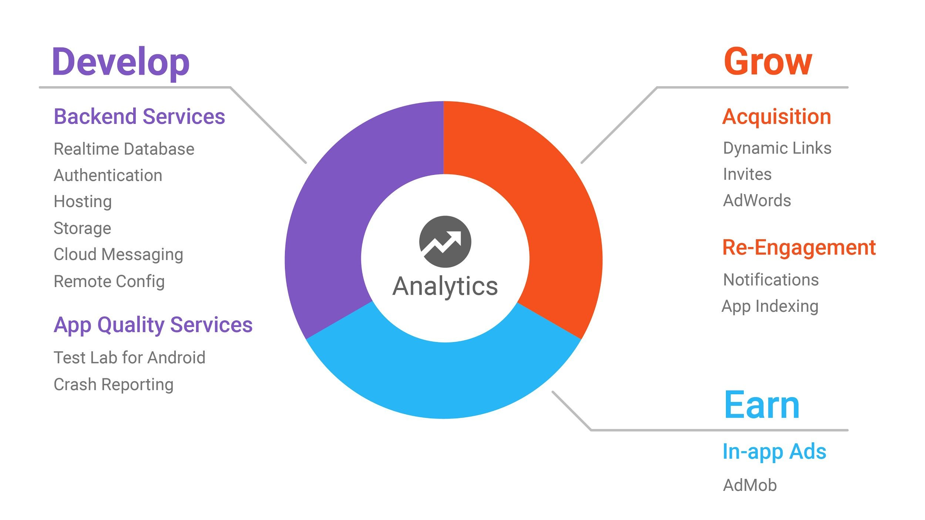
COMMON SKILS

Slide 33

COMMON SKILS
Git is a version-control system for tracking changes in computer files and coordinating work on those files among multiple people.
It is primarily used for source-code management in software development, but it can be used to keep track of changes in any set of files.

Slide 34
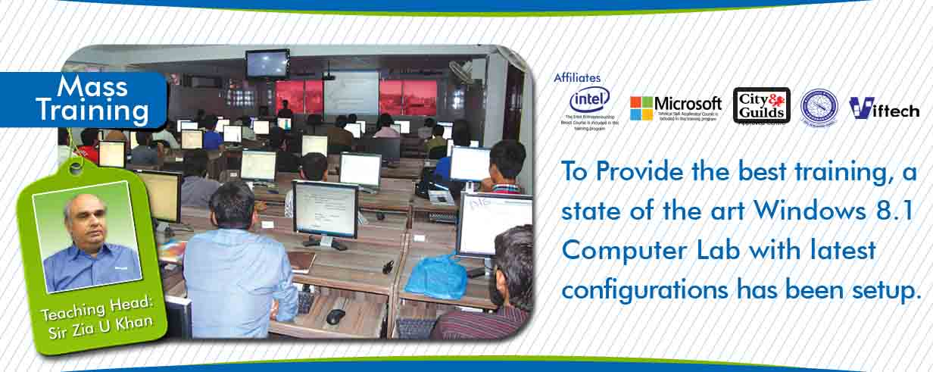
HOW TO LEARN IT?
Documentations.
Read Articles.
Online Tutorials
https://freetutorials.us
Join Forums,
Community

Slide 35

CAN I DO?

Slide 36
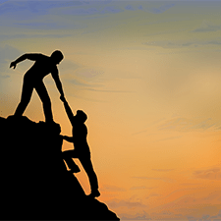

ONE MORE THING

Slide 37

ONE MORE THING

Slide 38

ONE MORE THING

Slide 39


